Slide 1

Project Presentation
on
ChainBallot
‘A Smart Contract Approach to Decentralized Electoral Systems’
Presented by
Shaikh Saaiem Salaar - 221846
Kumayl Sayed – 221838
Altamash Shamoil - 221847
Under the guidance of
Mehek Qureshi
Department of Computer Science & Engineering (IoTCSBCT), MHSSCE, Mumbai

Slide 2
Outline
Introduction
Problem Statement
Objectives
Summary of Work done
Literature Review
Proposed framework
Methodology
Results
Conclusion
References in IEEE format
Department of Computer Science & Engineering (IoTCSBCT), MHSSCE, Mumbai

Slide 3
INTRODUCTION
Traditional voting systems often face challenges such as lack of transparency, security risks, and dependency on centralized authorities.
This project introduces A Smart Contract Approach to Decentralized Electoral Systems, designed to provide a secure, transparent, and tamper-proof digital election platform.
By leveraging smart contracts and blockchain technology, the system ensures fairness, immutability, and trust, without the need for intermediaries.
Department of Computer Science & Engineering (IoTCSBCT), MHSSCE, Mumbai

Slide 4




Problem Statement
Objectives
Traditional voting systems lack transparency, security, and resistance to tampering, creating the need for a reliable and trustless digital electoral solution.
Department of Computer Science & Engineering (IoTCSBCT), MHSSCE, Mumbai

Slide 5



Summary of Work Done
Objectives
FRONT-END
BACK-END
The frontend of the system was developed using HTML, CSS, and JavaScript to create an interactive and user-friendly voting interface. MetaMask integration was implemented to enable secure wallet-based authentication and allow users to connect to the Ethereum blockchain seamlessly. The interface allows voters to register, cast votes, and view election results in real time.
Decentralization
Develop a blockchain-based online voting platform without centralized control.
Security
Ensure voter data protection, privacy, and resistance to tampering.
Transparency
Enable public auditability and real-time result verification
Eliminate Intermediaries
Remove third-party involvement to prevent manipulation or interference.
On the backend, Node.js was used to manage application logic and handle communication between the frontend and the blockchain. Smart contracts were written in Solidity and deployed on the Ethereum platform to securely manage voter verification, vote casting, and automatic vote counting. Web3.js was integrated to connect the application with the blockchain, while Ganache was used for local blockchain testing and development.
Department of Computer Science & Engineering (IoTCSBCT), MHSSCE, Mumbai

Slide 6
Summary of Work Done
Literature Review
FRONT-END
BACK-END
The frontend of the system was developed using HTML, CSS, and JavaScript to create an interactive and user-friendly voting interface. MetaMask integration was implemented to enable secure wallet-based authentication and allow users to connect to the Ethereum blockchain seamlessly. The interface allows voters to register, cast votes, and view election results in real time.
On the backend, Node.js was used to manage application logic and handle communication between the frontend and the blockchain. Smart contracts were written in Solidity and deployed on the Ethereum platform to securely manage voter verification, vote casting, and automatic vote counting. Web3.js was integrated to connect the application with the blockchain, while Ganache was used for local blockchain testing and development.
Department of Computer Science & Engineering (IoTCSBCT), MHSSCE, Mumbai

Slide 7
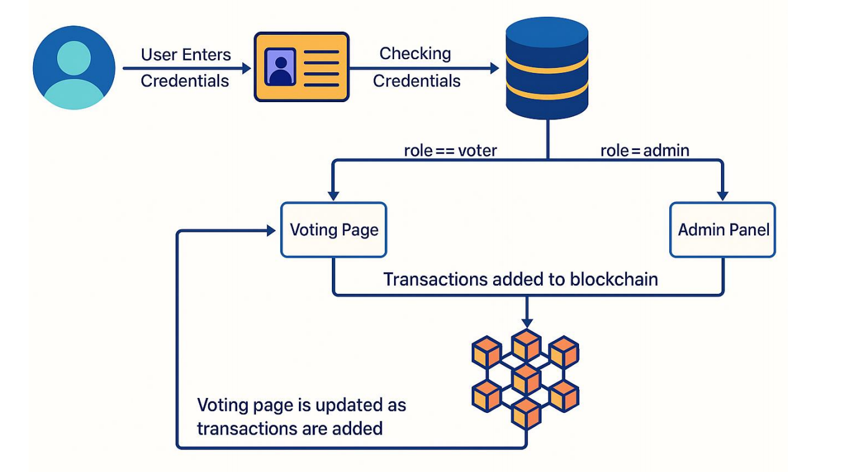
Proposed Framework
Literature Review
Year | Paper Title | Methodology | Findings | Improvement in Our Project
2018 | Blockchain-Based E-Voting System | Smart contracts for vote storage | High gas fees, no instant results display | Optimized contract design with real-time on-the-spot vote counting
2019 | Secure E-Voting Using Blockchain | Cryptographic security & decentralization | Limited user interface, complex voter access | User-friendly frontend with MetaMask authentication
2020 | Decentralized Voting DApp | Ethereum-based voting platform | No strong voter verification logic | Secure voter validation with automated smart contract control
2021 | Smart Contract Voting Framework | Automated vote tallying | Vulnerable to contract design flaws | Tested using Ganache and structured contract logic for reliability
2022 | Hybrid Blockchain Voting Model | Combined traditional + blockchain methods | Increased complexity, partial centralization | Fully decentralized architecture with transparent real-time results
FRONT-END
BACK-END
User Login : User enters credentials (voter/admin).
Credential Verification : Credentials are checked against the MySQL database.
Role-Based Routing
voter → Redirected to Voting Page
admin → Redirected to Admin Panel
Blockchain Interaction : Actions (like casting a vote) trigger smart contract transactions on the Ethereum blockchain.
Real-Time Updates : The Voting Page updates as blockchain transactions are recorded.
The frontend of the system was developed using HTML, CSS, and JavaScript to create an interactive and user-friendly voting interface. MetaMask integration was implemented to enable secure wallet-based authentication and allow users to connect to the Ethereum blockchain seamlessly. The interface allows voters to register, cast votes, and view election results in real time.
On the backend, Node.js was used to manage application logic and handle communication between the frontend and the blockchain. Smart contracts were written in Solidity and deployed on the Ethereum platform to securely manage voter verification, vote casting, and automatic vote counting. Web3.js was integrated to connect the application with the blockchain, while Ganache was used for local blockchain testing and development.
Department of Computer Science & Engineering (IoTCSBCT), MHSSCE, Mumbai

Slide 8
Proposed Framework
User Login : User enters credentials (voter/admin).
Credential Verification : Credentials are checked against the MySQL database.
Role-Based Routing
voter → Redirected to Voting Page
admin → Redirected to Admin Panel
Blockchain Interaction : Actions (like casting a vote) trigger smart contract transactions on the Ethereum blockchain.
Real-Time Updates : The Voting Page updates as blockchain transactions are recorded.
Department of Computer Science & Engineering (IoTCSBCT), MHSSCE, Mumbai

Slide 9
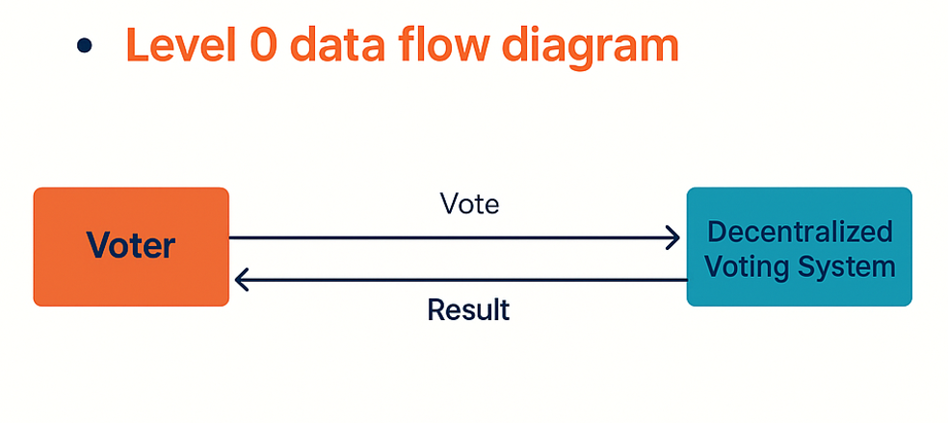
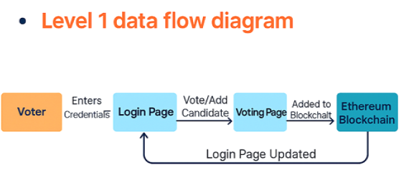
Methodology
Department of Computer Science & Engineering (IoTCSBCT), MHSSCE, Mumbai

Slide 10
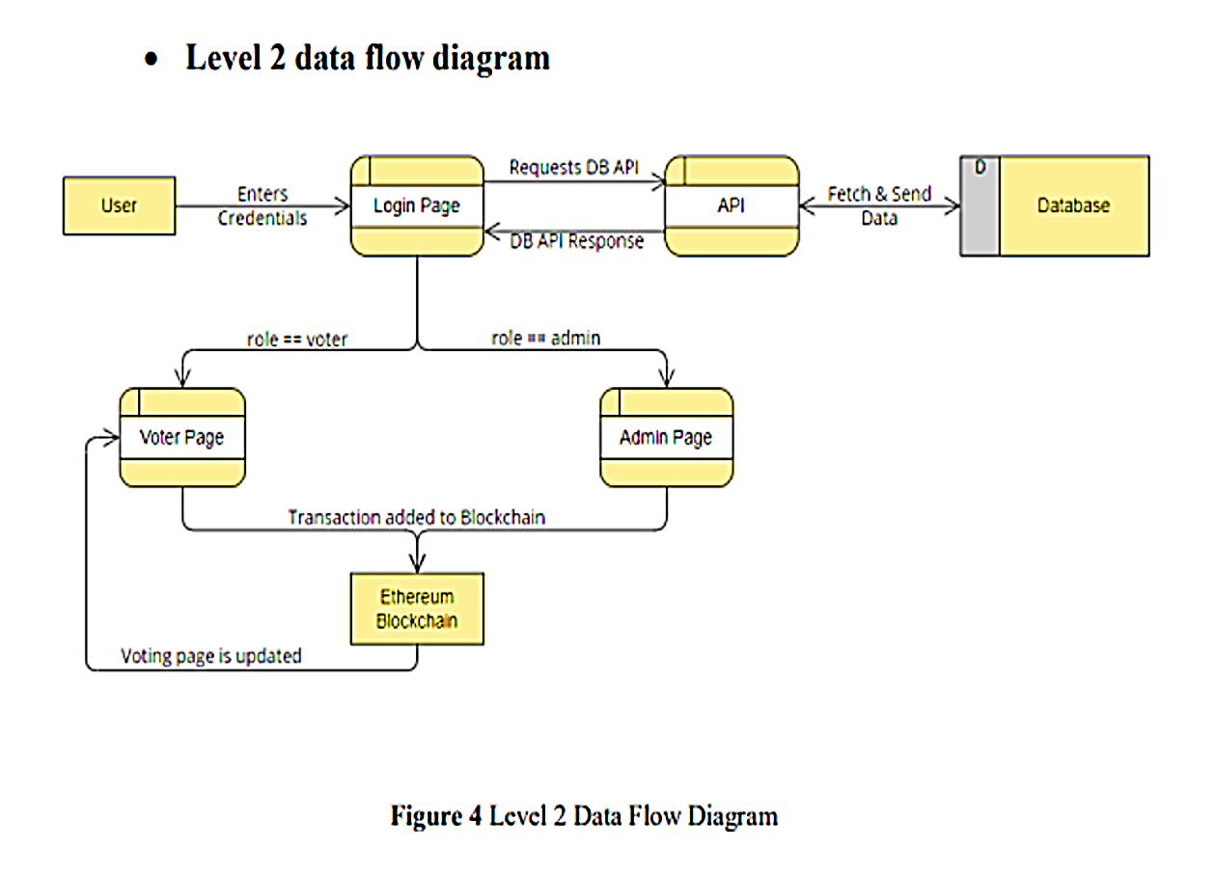
Methodology
Department of Computer Science & Engineering (IoTCSBCT), MHSSCE, Mumbai

Slide 11
Results
The developed decentralized voting system was successfully implemented and tested using the Ethereum blockchain. Voters were able to securely connect their wallets via MetaMask, cast their votes, and view results in real time.
Smart contracts executed vote recording and automated counting accurately without any third-party intervention. The system ensured transparency, immutability, and tamper resistance throughout the election process.
Testing using Ganache demonstrated reliable performance, secure vote storage, and instant on-the-spot vote counting with accurate result generation.
Department of Computer Science & Engineering (IoTCSBCT), MHSSCE, Mumbai

Slide 12
Conclusion
The proposed Decentralized Voting System successfully demonstrates how blockchain technology can enhance transparency, security, and trust in digital elections. By leveraging Ethereum smart contracts, the system ensures tamper-proof vote recording, automated vote counting, and elimination of intermediaries.
The integration of MetaMask authentication and a user-friendly frontend makes the platform practical and accessible. Overall, the project provides a reliable, secure, and efficient solution for modern online voting systems.
Department of Computer Science & Engineering (IoTCSBCT), MHSSCE, Mumbai

Slide 13
References
[1] A. Kiayias, T. Zacharias, and B. Zhang, “End-to-End Verifiable Elections in the Standard Model,” IEEE Symposium on Security and Privacy, pp. 468–483, 2015.
[2] K. Christidis and M. Devetsikiotis, “Blockchains and Smart Contracts for the Internet of Things,” IEEE Access, vol. 4, pp. 2292–2303, 2016.
[3] S. Nakamoto, “Bitcoin: A Peer-to-Peer Electronic Cash System,” 2008. [Online]. Available: https://bitcoin.org/bitcoin.pdf
[4] A. Kshetri and J. Voas, “Blockchain-Enabled E-Voting,” IEEE Software, vol. 35, no. 4, pp. 95–99, July/Aug. 2018.
[5] M. Pawlak, M. Poniszewska-Maranda, and M. Kryvinska, “Towards the Intelligent Agents for Blockchain e-Voting System,” Procedia Computer Science, vol. 141, pp. 239–246, 2018.
[6] A. T. Sherman et al., “On the Use of Blockchain for Electronic Voting,” International Conference on Financial Cryptography and Data Security, 2019.
Department of Computer Science & Engineering (IoTCSBCT), MHSSCE, Mumbai

Slide 14
THANK YOU
PRESENTED BY :
SHAIKH SAAIEM SALAAR
KUMAYL SAYED
Altamash Shamoil

